Slide 1
Handwriting Reader
PowerUp Automation
BENGALURU
PIYUSH KUMAR
APOORV TOMAR
#UIPathDev #PowerUpAutomation

Slide 2
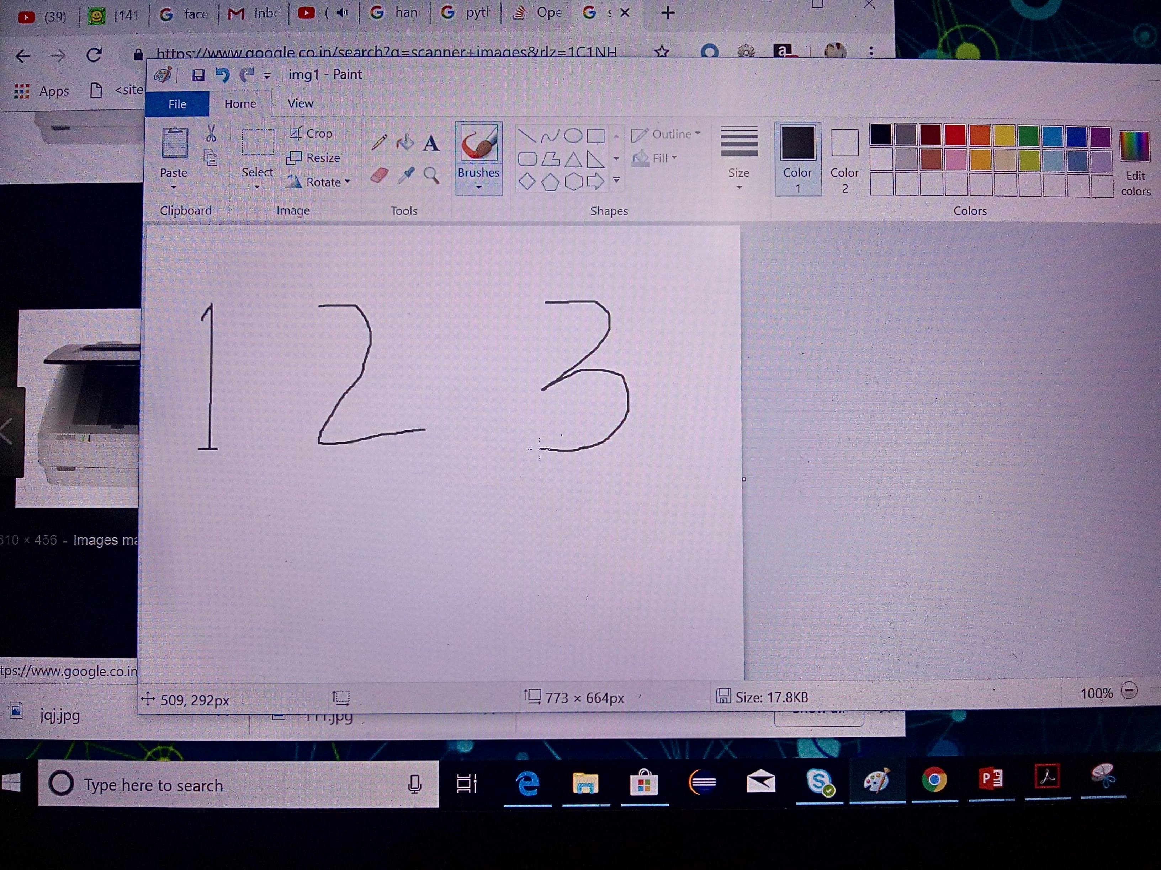
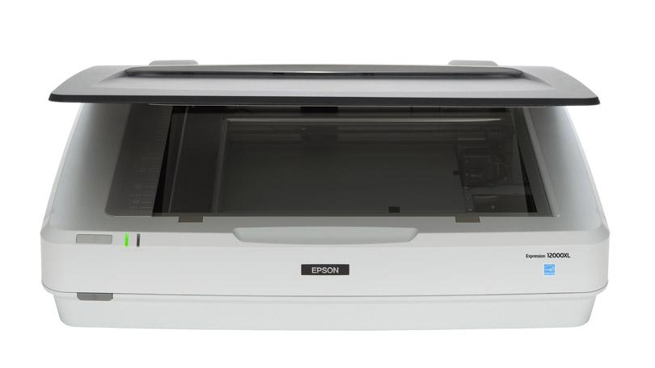
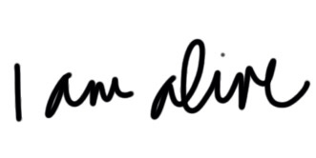
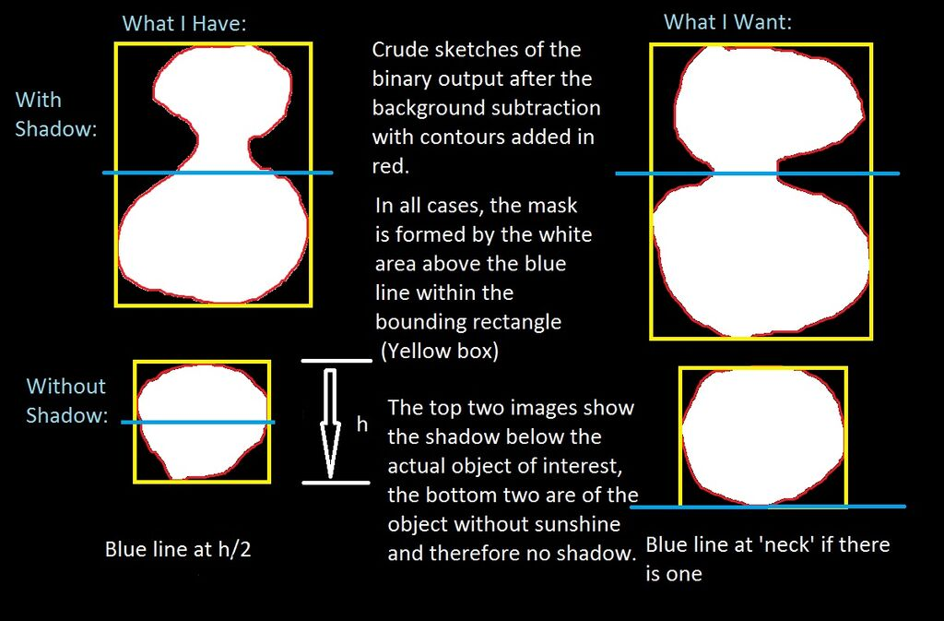
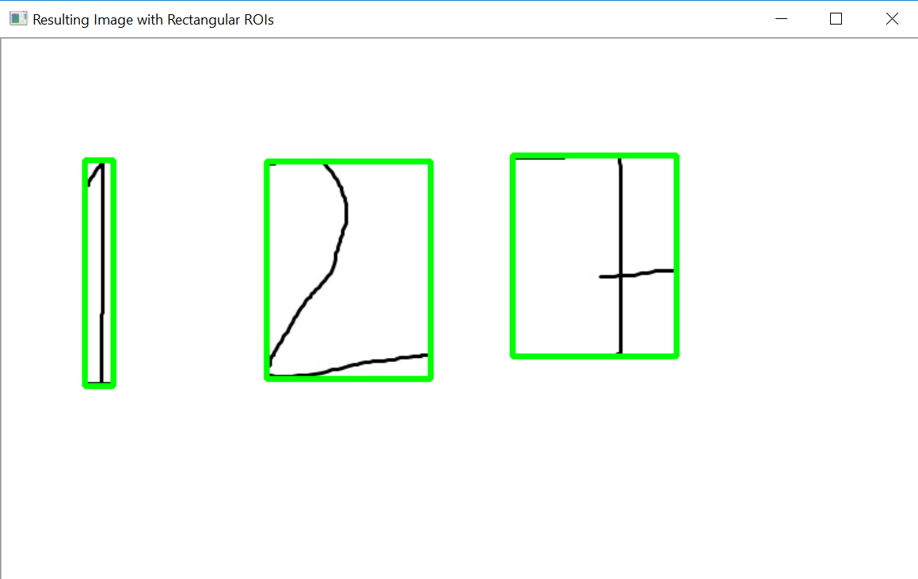
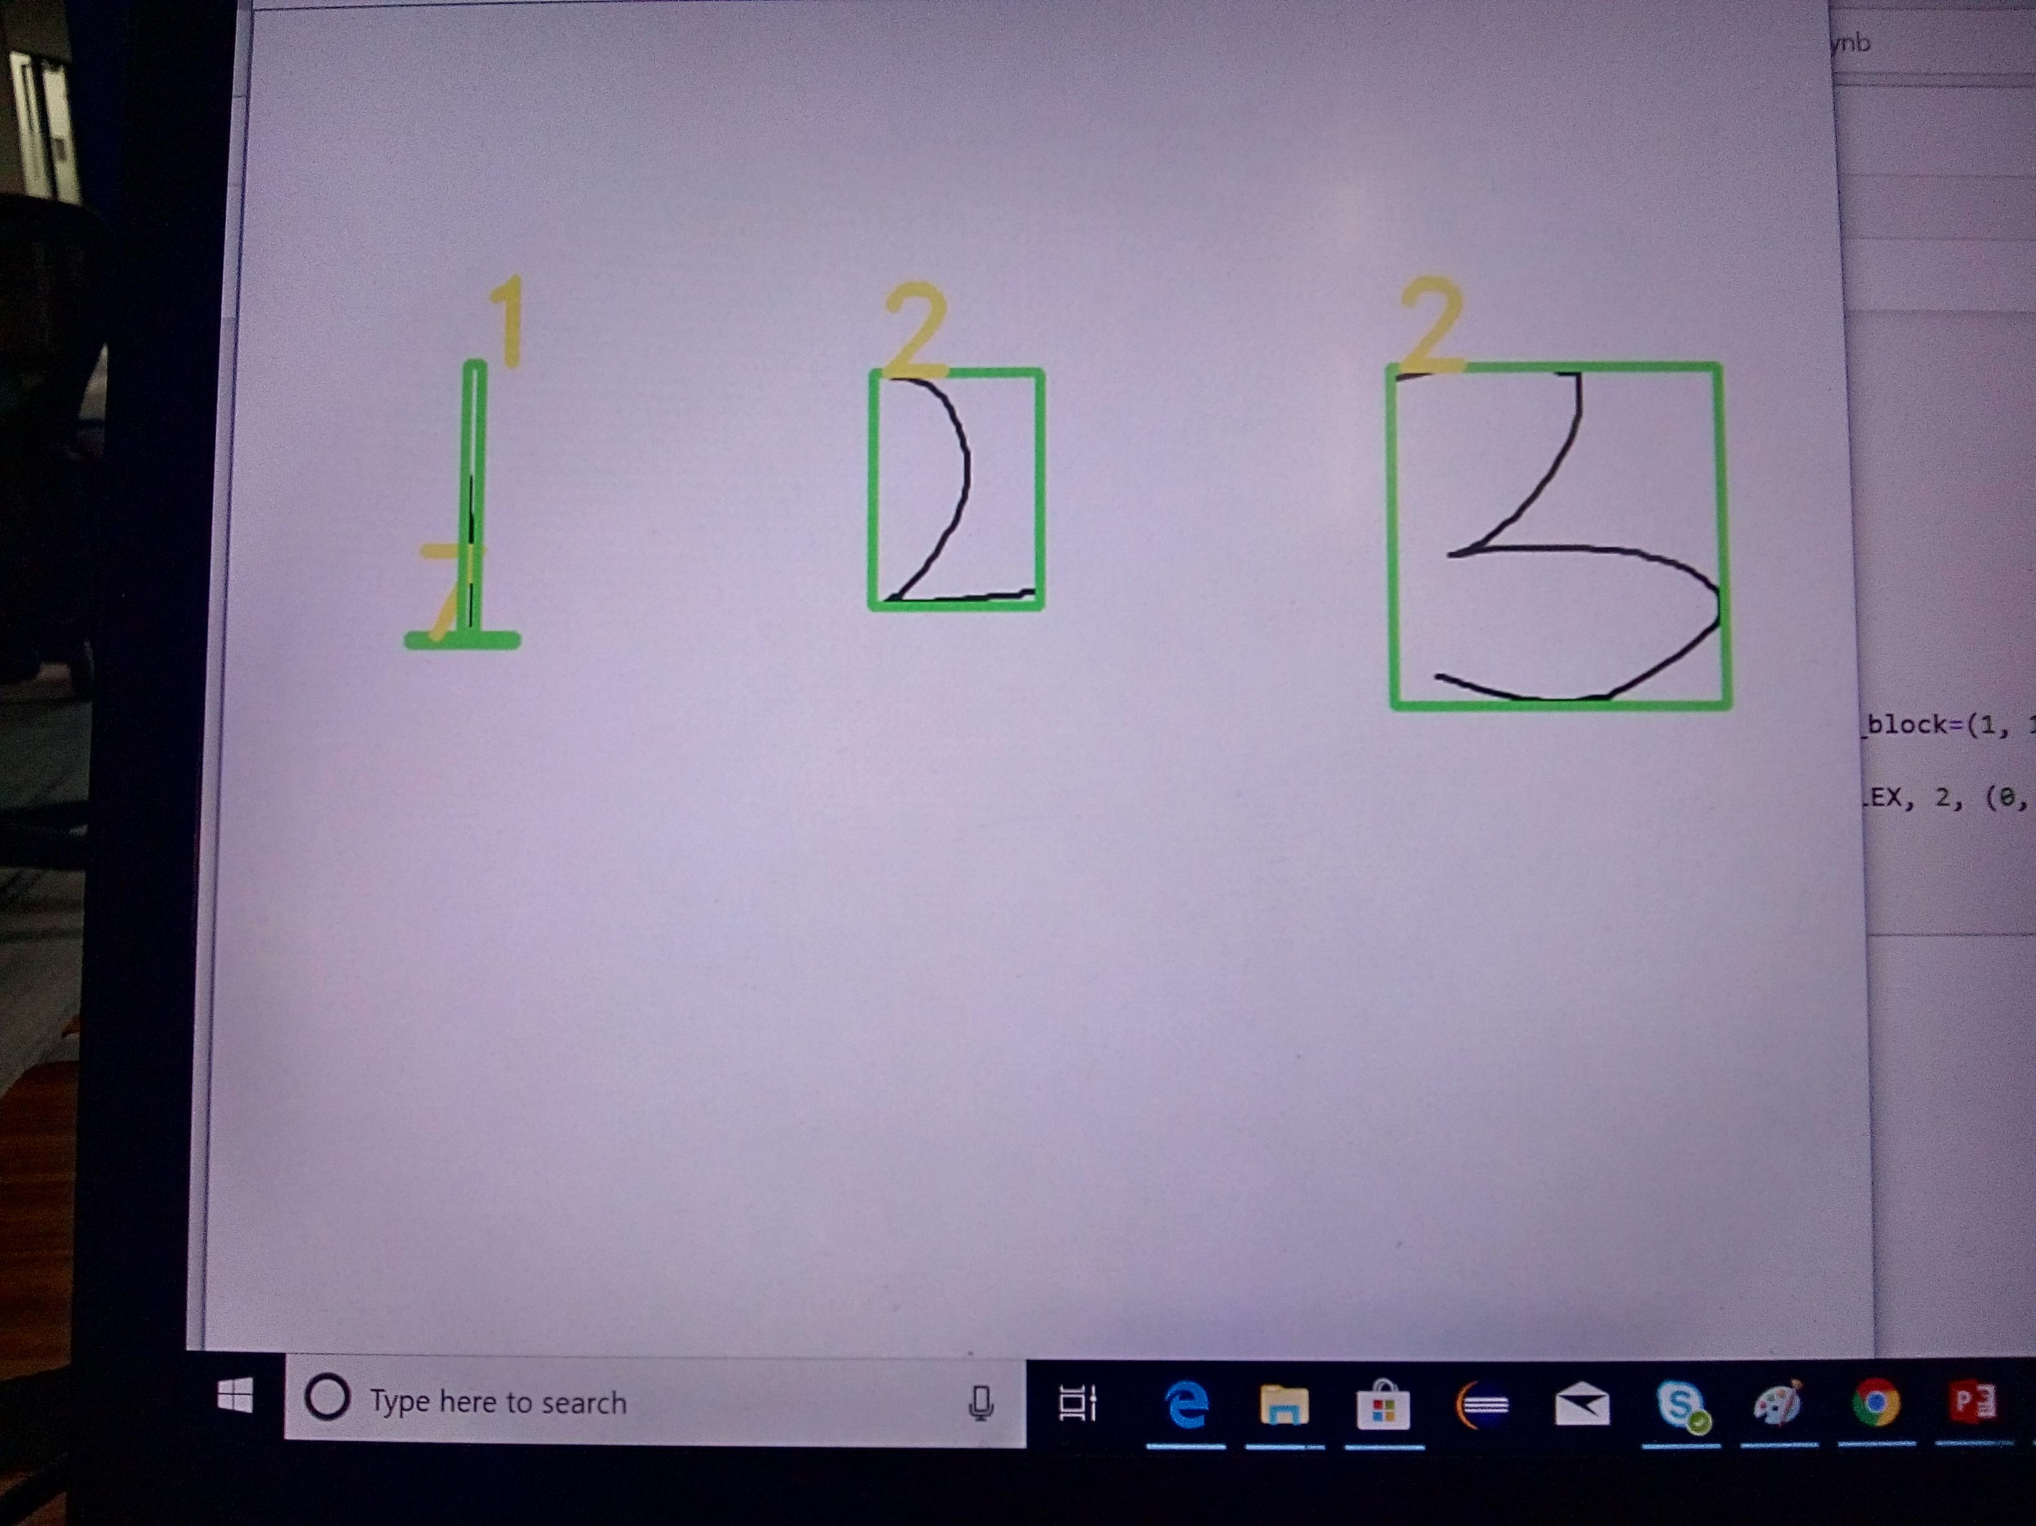
Proposed Model
UIPATH
STUDIO
Scanning handwriting image
through scanner
Handwritten doc
Segmented image
Processed Text
Character Recognition model

Slide 3
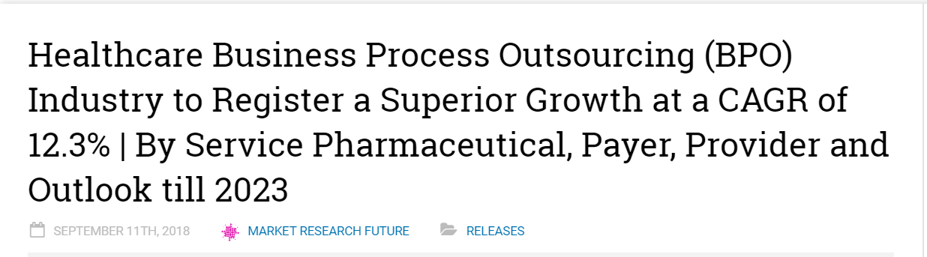
Business Application
Automation of Manual Data Entry

